Slide 1



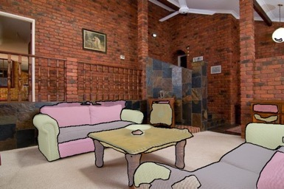
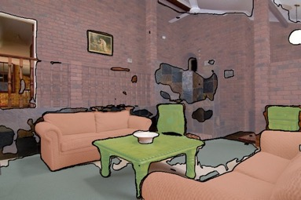
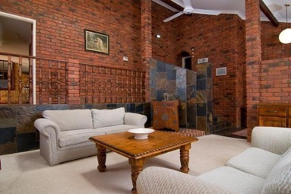
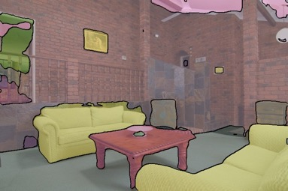
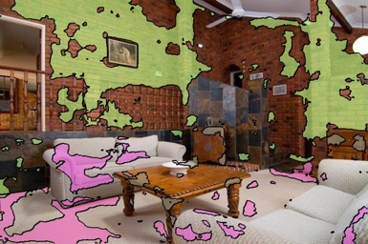
Unified Perceptual Parsing for Scene Understanding
Tete Xiao^{1*}, Yingcheng Liu^{1*}, Bolei Zhou^{2*}, Yuning Jiang³, Jian Sun⁴ ¹Peking University & ²MIT CSAIL & ³ByteDance Inc. & ⁴Megvii Inc.
* Indicates equal contribution
Paper, code, and data are available:
https://github.com/CSAILVision/unifiedparsing
Understanding Scenes at Multiple Levels
Unified Perceptual Parsing Network
Segmentation Result
Parts
Materials
UPerNet is proposed to learn from heterogeneous data
- It exploits the natural hierarchy of neural networks.
- It is efficient, without dilated convolutions
- sofa is composed of seat cushion , arm, back pillow and seat base.
- cabinet is made of wood.
- coffee table is composed of leg , apron and top.
brick
- table is made of wood.
back pillow
door
drawer
wood
wood
- wall is made of brick.
arm
top
fabric
- sofa is made of fabric.
seat cushion
arm
wood
seat base
apron
seat cushion
fabric
- floor is made of carpet.
leg
back pillow
carpet
Scene
Objects
ceiling
Textures
Living room
mirror
painting
ceiling
- coffee table is waffled.
mirror
painting
wall
stratified
- sofa is knitted.
windowpane
wall
- wall is stratified.
windowpane
cabinet
stratified
sofa
cabinet
sofa
cabinet
coffee table
cabinet
knitted
floor
coffee table
sofa
waffled
floor
sofa
porous
Discovering Visual Relations
- living room is composed of wall, floor, ceiling, coffee table, cabinet and painting.
Our contributions:
- A new parsing task called Unified Perceptual Parsing, which parses concepts such as textures, materials, objects, and object parts.
- Unified Perceptual Network (UPerNet) is proposed to segment as many visual concepts as possible.
Discovered scene-object relations
Definition of Unified Perceptual Parsing
FPN: Feature Pyramid Network (Lin et al., CVPR ‘17)
PPM: Pyramid Pooling Module (Zhao et al., CVPR ‘17)
Merging heterogeneous visual datasets into one training set
UPerNet on ADE20K for semantic segmentation
Standardized Broden Dataset
Category | # Classes | Source | Metric
Scene | 365 | ADE (Zhou et al., CVPR’17) | Top-1 Acc.
Object | 335 | ADE, Pascal-Context (Mottaghi et al., CVPR ‘14) | mIoU & P.A.
Part | 152 | ADE, Pascal-Part (Chen et al., CVPR ‘14) | mIoU & P.A.
Material | 26 | OpenSurfaces (Bell et al., SIGGRAPH ‘14) | mIoU & P.A.
Texture | 47 | DTD (Cimpoit et al., CVPR ‘14) | Top-1 Acc.
State-of-the-art performance
Good balance on computational complexity
Discovered other visual relations
UPerNet on Broden+ for unified perceptual parsing
O: Object. P: Part. S: Scene. M: Material. T: Texture. mI.: mean IoU. P.A.: pixel accuracy. mI.(bg): mean IoU including background. T-1: top-1 accuracy.

